Slide 1
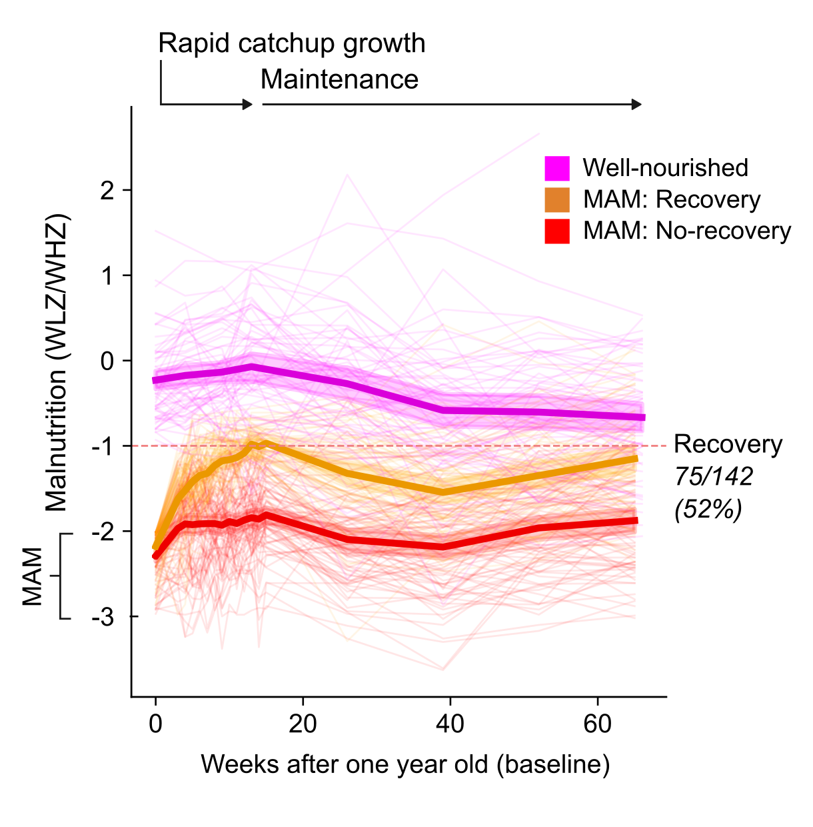
VERSION 1
Figure 1: Half of the children recovered from moderate acute malnutrition after refeeding. Lineplot of how children change in WLZ/WHZ.

Slide 2
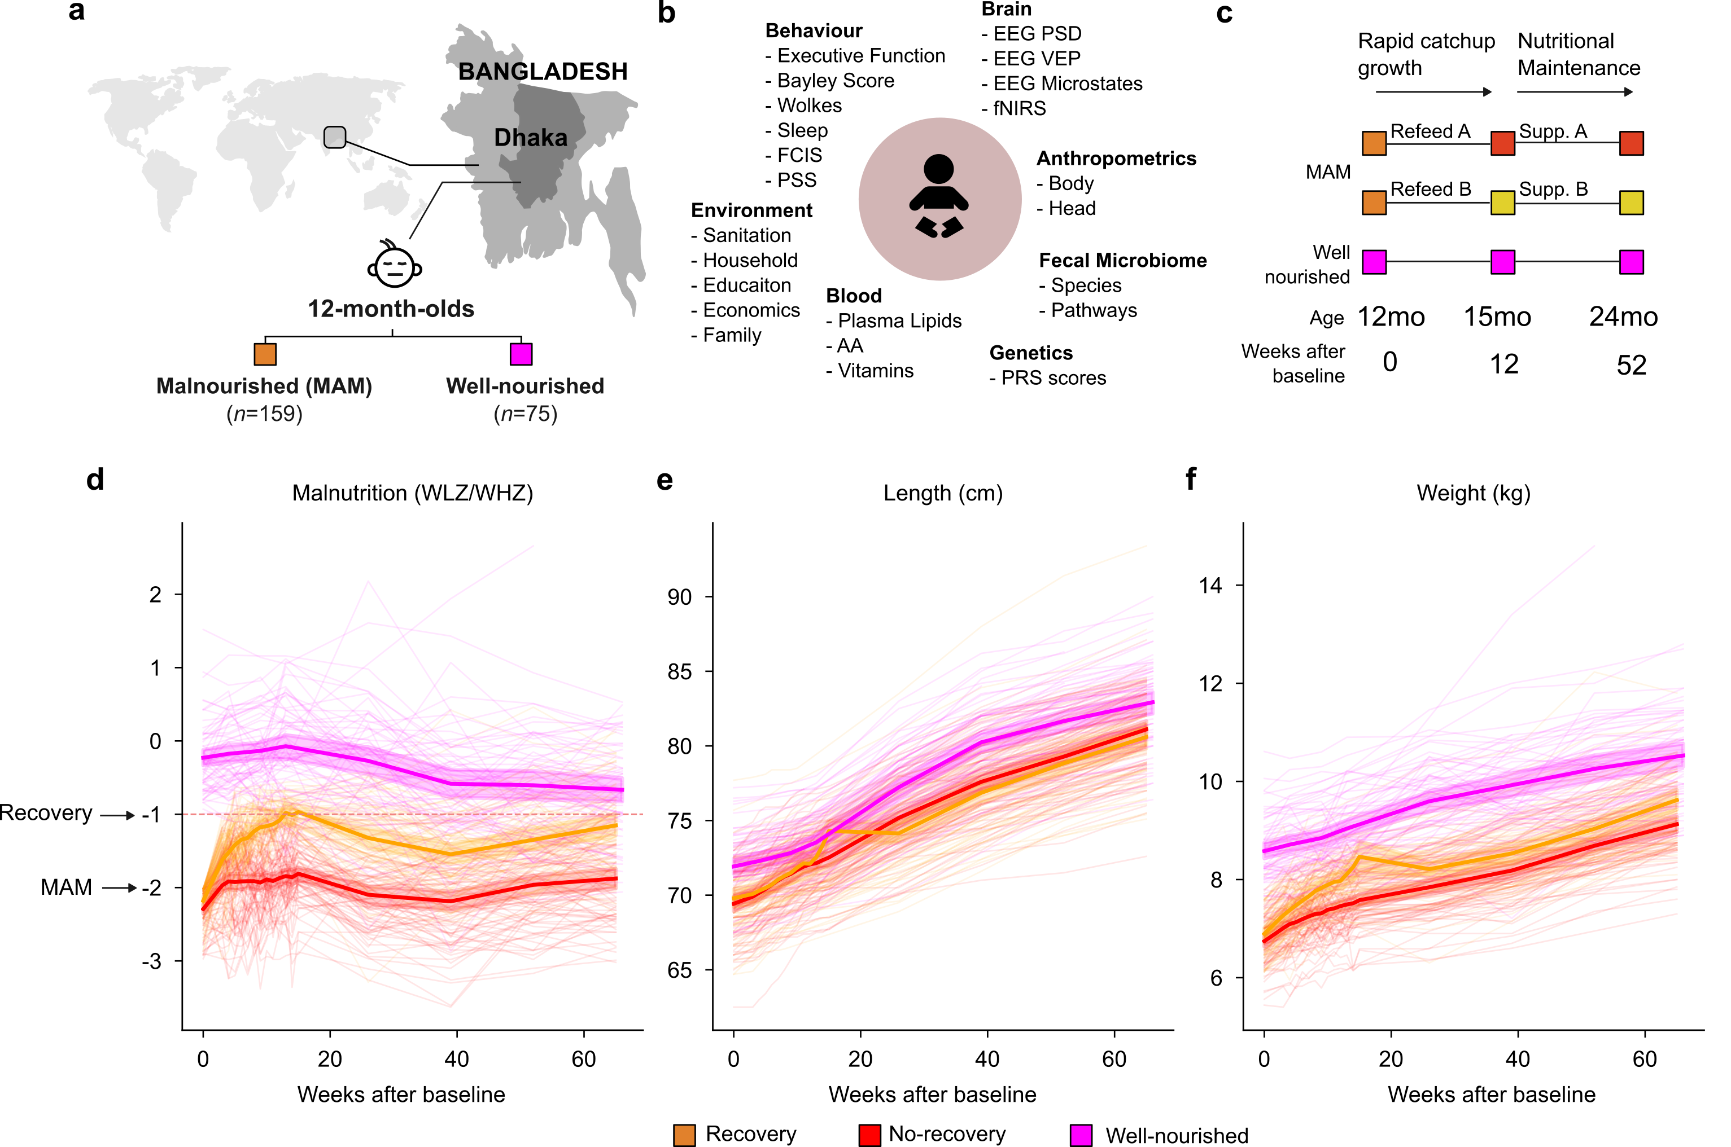
VERSION 2
Figure 1: Half of the children recovered from moderate acute malnutrition after refeeding. A, schematic of geography of data collection. B, Summary of datasets collected of this cohort. C, Refeeding strategy for the children. D, E, and F show how children change in WLZ/WHZ, length (cm) and weight (kg) respectively.

Slide 3
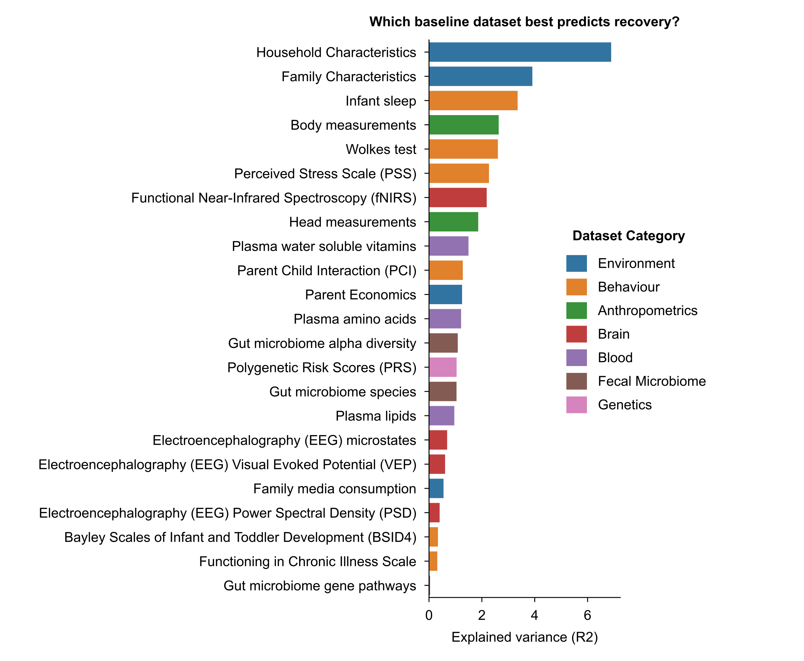
Figure 2: Baseline factors predict recovery. Explained variance as measured by PERMANOVA of beta diversities between samples within each dataset.

Slide 4
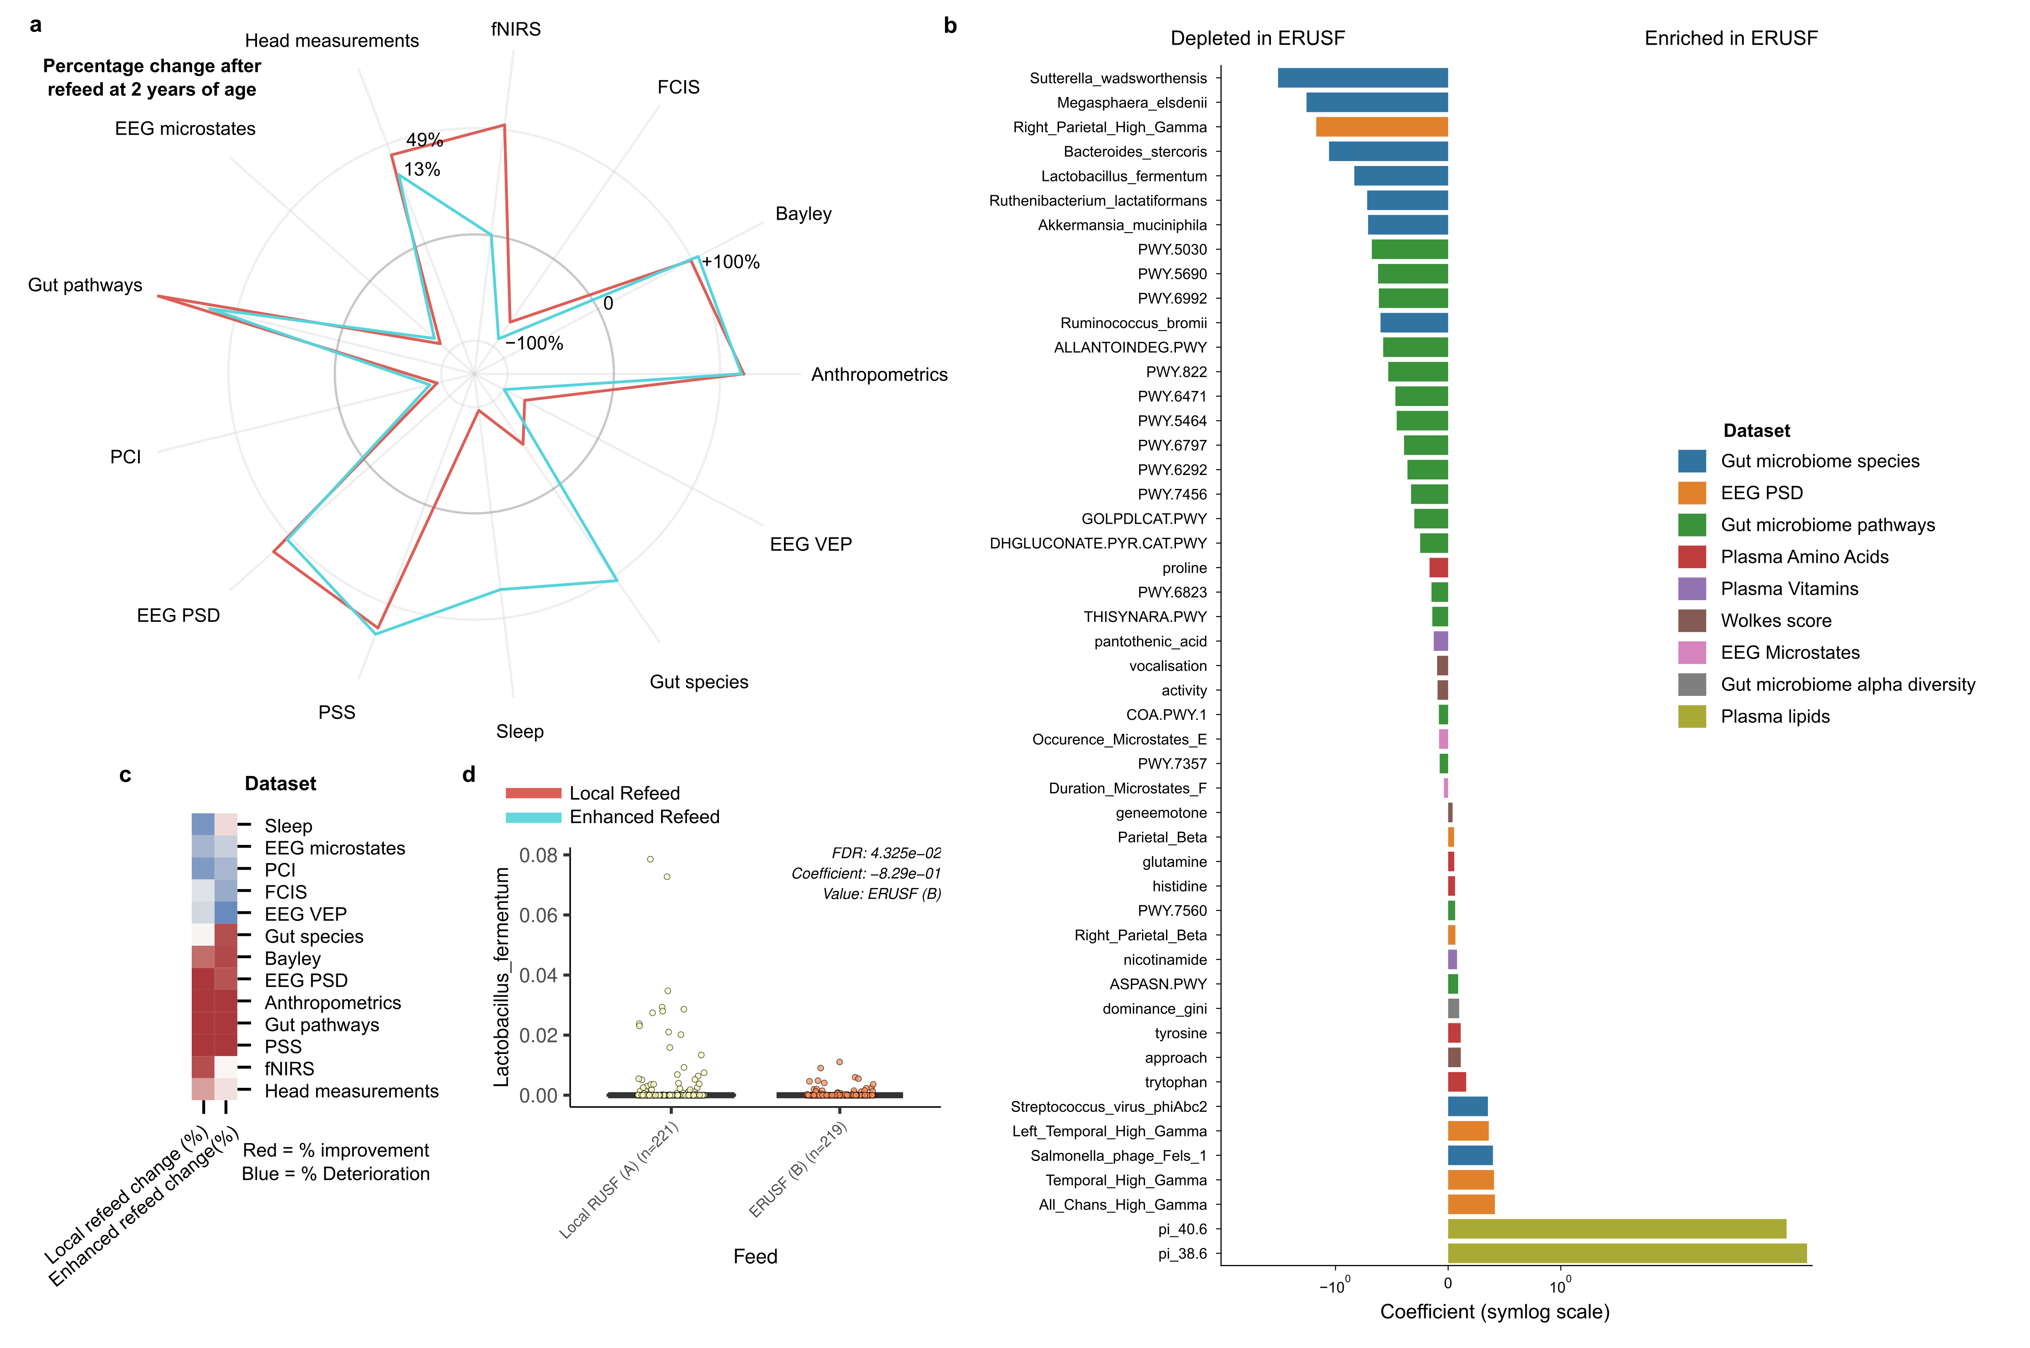
Figure 3: Refeed methods improve/deteriorate bodily systems differently. A, Radial plot of percentage change in distance from Well-nourished controls before and after refeeding (1yr and 2yr). Positive and negative percentages represent improvement and deterioration, respectively. B, Horizontal barplot of features that explain the change significantly (q < 0.2) between refeed methods after mixed modelling for each dataset. C, Heatmap to show clusters of dataset changes. D, Boxplot to show how Lactobacillus fermentum changes according to the refeed method.

Slide 5
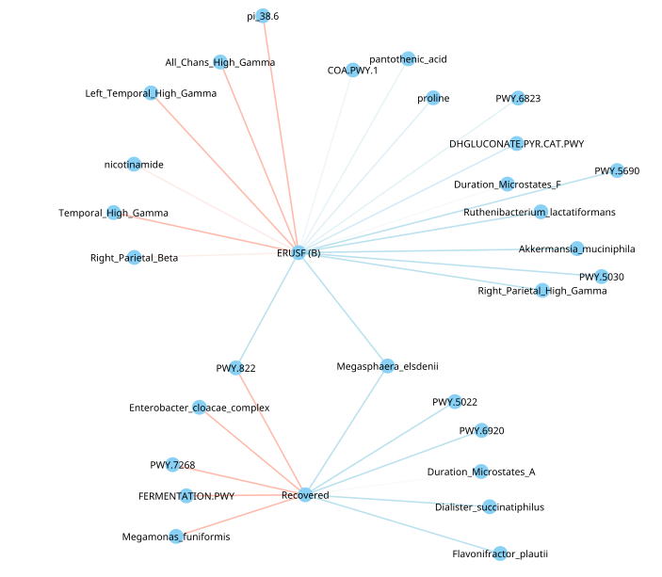
Figure 4: Enhanced refeed method may improve brain function in temporal gamma power in infants that recovered. Nodes are features and edges are significant associations as calculated using Maaslin2

Slide 6
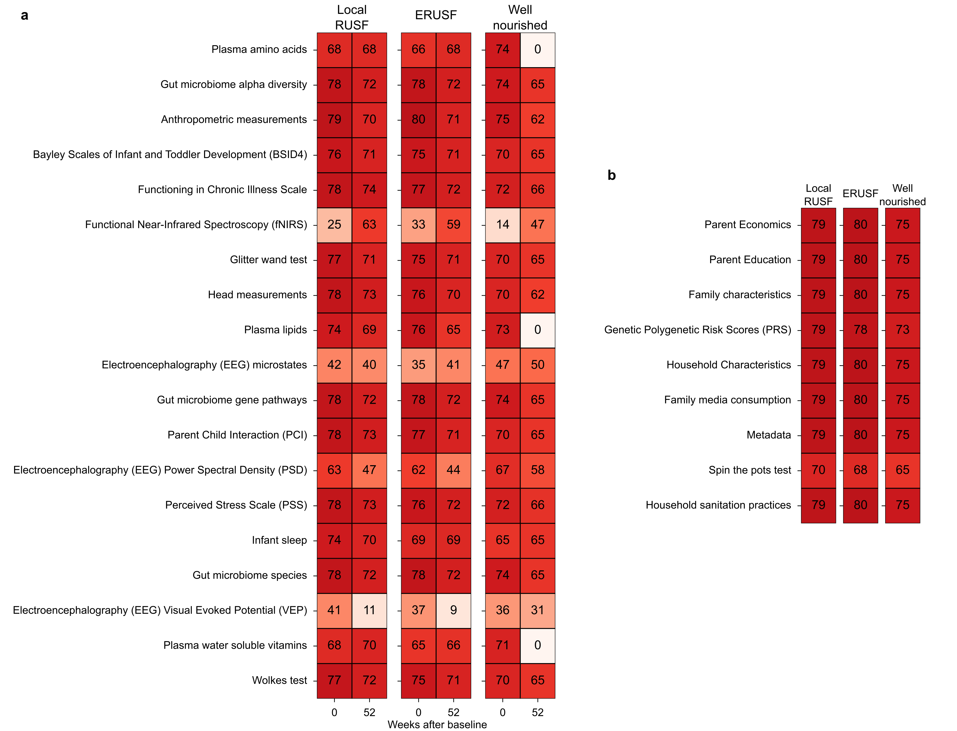
Figure S1: Heatmap of sample number counts for each dataset. A, B Time series and non-time series dataset counts.

Slide 7
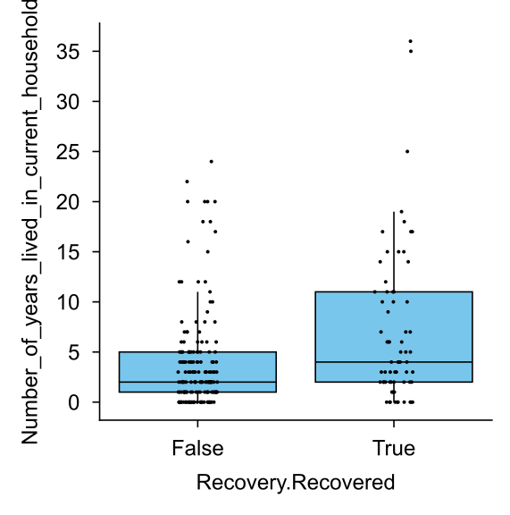
Interesting extras:

